Slide 1
Magnetic Fields

Slide 2
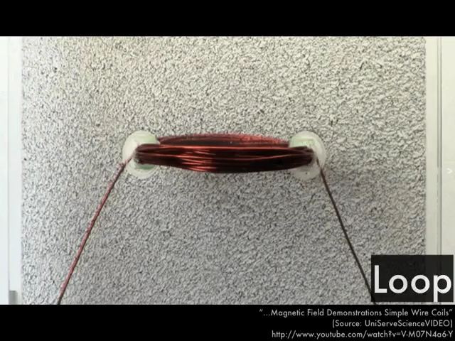
By the end of this lesson, you should be able to:
Explain what a magnetic field is.
Outline how magnetic flux lines convey information about the strength of the magnetic force.
Name the principle that allows magnetic fields to interact.
Draw simple magnetic fields, such as the magnetic field of a bar magnet.

Slide 3
A magnetic field is the area around the magnet where there is a magnetic force.
Moving electric charges also produce magnetic fields, but you don't need to worry about that for a while.
We use magnetic flux lines (also called magnetic field lines) to show the magnetic field around a magnet. You can actually see the magnetic flux lines if iron filings are scattered around the magnet!

Slide 4
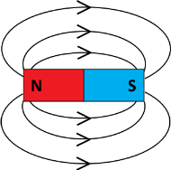
Magnetic flux lines always come out of the north pole of a magnet and go into the south pole.
This means that for bar magnets, the magnetic field comes out of the north pole then curves around to enter the south pole.

Slide 5
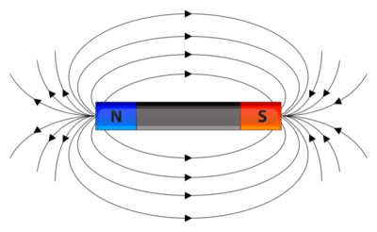
The strength of the magnetic field is represented by how close together the magnetic flux lines are.
When the lines are close together, it means that the magnetic field is strong. When they are spread apart, the magnetic field is weak.
For example, in the diagram below, you can see that the magnetic flux lines are much closer together near the poles than on the sides of the bar magnet.

Slide 6
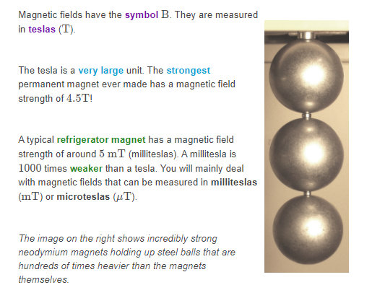
There is a particular unit that is used to measure the strength of a magnetic field.

Slide 7
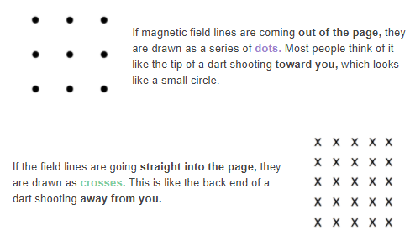
Sometimes when you are working out problems involving magnetic fields, the fields go into or out of the page.
We have special notation to represent these fields.

Slide 8
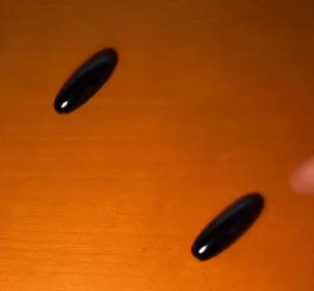
When two magnets are close together, their magnetic fields interact.
This is occurs because of the superposition principle.
If the magnetic fields of two magnets are pointing in the same direction, the fields will add together. This means that the magnetic force will be stronger.
If the fields point in opposite directions, they will cancel out. This will make the magnetic force weaker.

Slide 9

The easiest example of the superposition of magnetic fields is two bar magnets that have opposite poles facing each other.
In this scenario, the magnetic flux lines come out of one magnet's north pole and go into the other magnet's south pole.
This creates a very strong magnetic force between the two magnets, so they are attracted to each other.

Slide 10
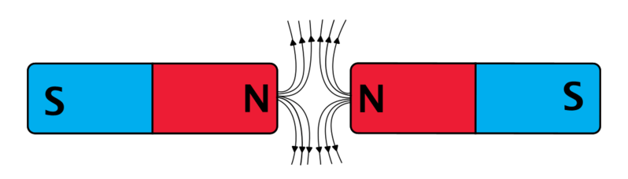
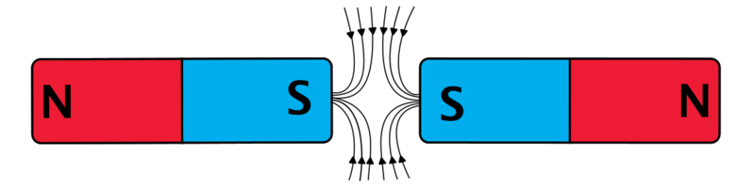
Something a little bit more complicated happens when the bar magnets have like poles facing together.
The diagrams below show the magnetic flux lines when two south poles or two north poles are held together.
In these diagrams, the magnetic flux lines are either both flowing inwards or both flowing outwards. This causes the magnetic fields to interact in such a way that the magnets are repelled.

